Slide 1
Album Cover - Printmaking
Grade 8 Semester Art
Notes:
What are album covers? What purpose do they serve?

Slide 2
Album Cover Designs
Used identifying specific records from one another
advertise the musical contents – inform the audience of what the music is.
target a specific demographic of people that the musical artist is targeting with their music.
artwork can be as much a part of the identity of a record as the sound.
provided designers with a way to express their creativity and gain global recognition

Slide 3
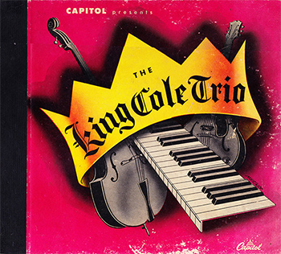
Graphic Design
Also known as Communication Design
The art of combining text and pictures
Graphic = very clear and powerful
Communicates a message or idea
Notes:
What genre can we assume this music is?
What symbolism is in the image?
What do the colors communicate?

Slide 4
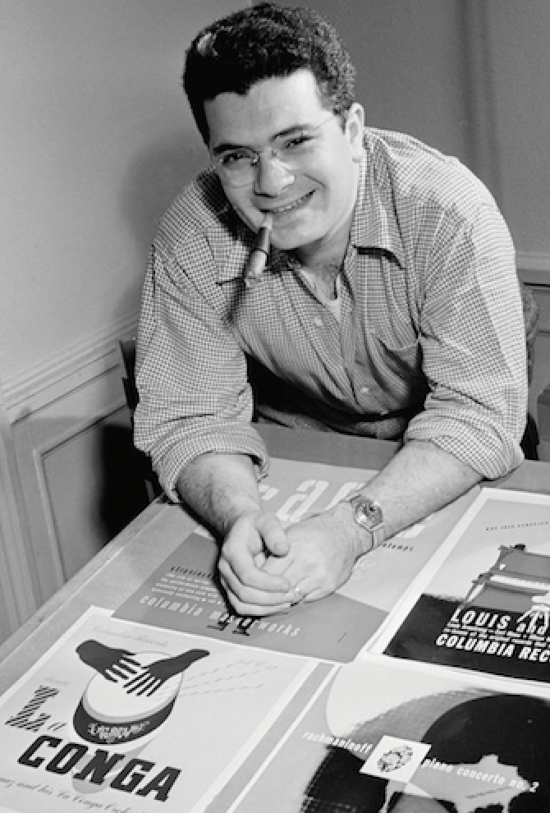
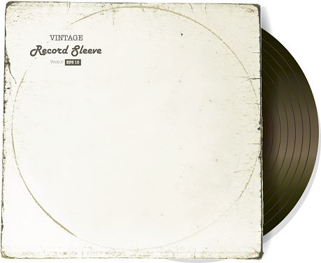
Alex Steinweiss
1917 - 2011
Graphic design artist, inventor of album cover art
Columbia Records’ first art director
Albums were typically packaged in dull cardboard or paper sleeves with the record label’s name stamped on it
“To my mind, this was no way to package beautiful music” “I wanted people to look at the artwork and hear the music.”
Sales went up 900% with his new way to package records

Slide 5
Steinweiss Covers
Known for combining illustration, color, and typography effortlessly
Modern, elegant type
Rich and vibrant colors
Lively illustration
Sometimes symbolic and conceptual
Other times fun and playful

Slide 6
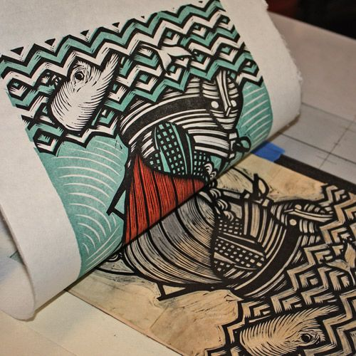
Printmaking
Transferring an image from a template onto another surface (usually paper)
Create multiples of one work of art
Each print is considered an original rather than a copy
Copy = EXACTLY the same
Print = some small variation or inconsistency

Slide 7
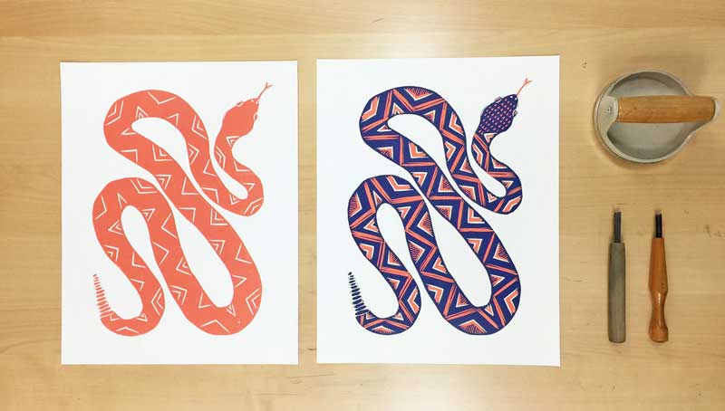
Reduction Print
Reduction print includes several colors printed from the same block at different stages
The artist carves away or “reduces” portions of a printing block
Prints one layer/color at a time

Slide 8
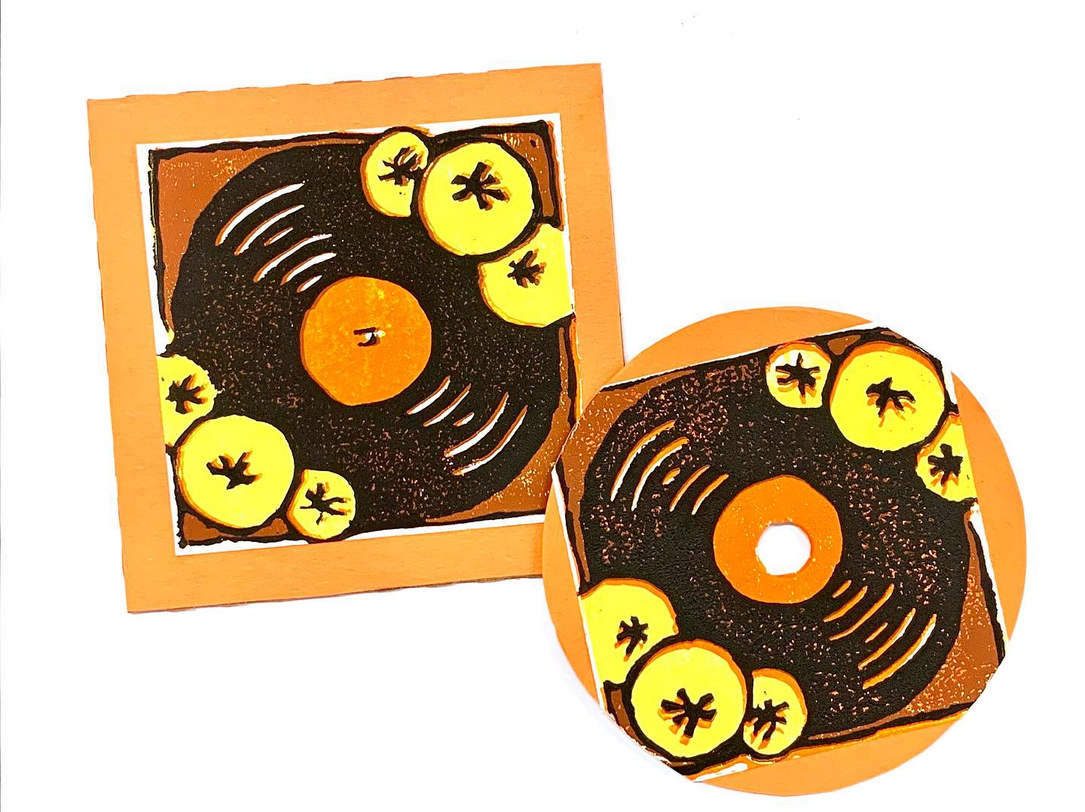
Your Challenge
- You will create an album cover for ONE song.
You will create a design that visually represents your chosen song.
We will create our album covers using reduction printmaking techniques.
Your final product will be pasted onto a real CD cover and the lyrics will be pasted on the back.

Slide 9
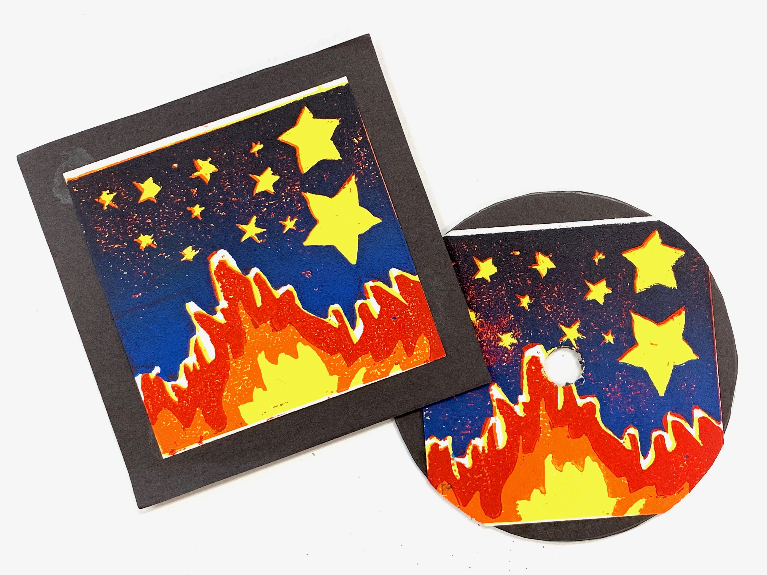
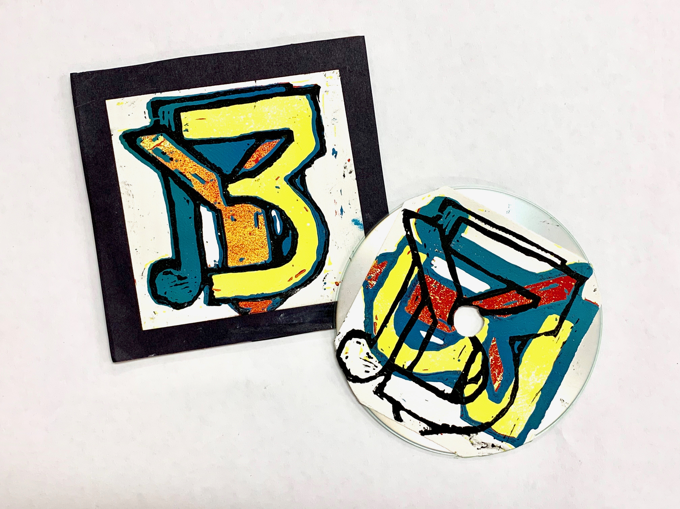
Student Examples

Slide 10
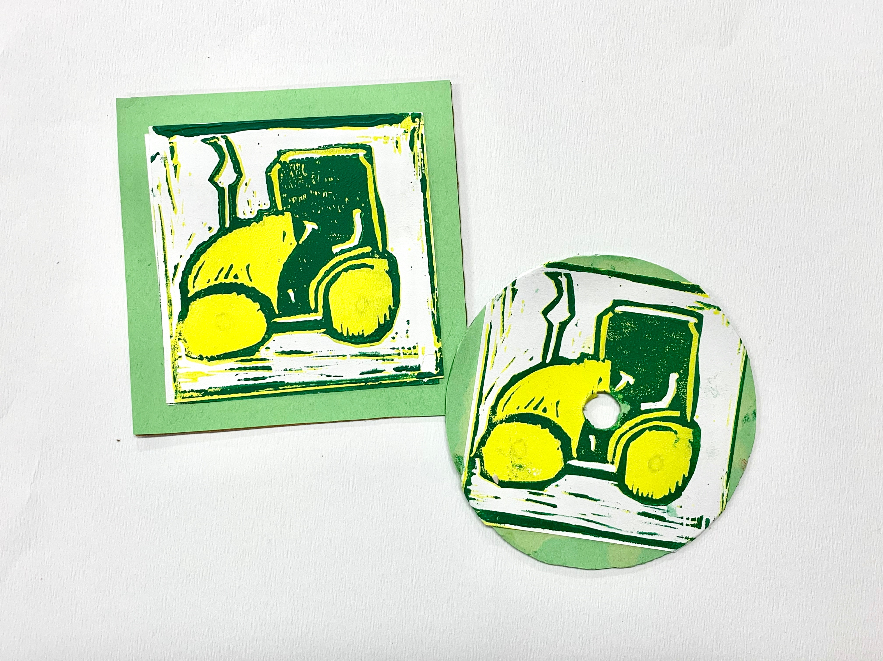

Slide 11
Brainstorming
Select one song with school appropriate lyrics
Create 4”X4” text box in word.
Copy and paste lyrics or main chorus or main inspiration for cover into the box. Adjust size and spacing so the full song fits into the box.
Submit to Canvas.
Listen to your song.
Begin sketching ideas, imagery, symbols, that come to mind when you listen to it. Maybe there is one specific line you want to represent.

Slide 12
Sketching
Create three quick thumbnail sketches of your design. Look up other album cover art to draw inspiration from.
We will only be using 3 colors and white. Think in terms of simpler shapes and lines.
Draw a 4”X4” square in your sketchbook. Draw final composition inside.
Color in using 3 colors and white.

Slide 13
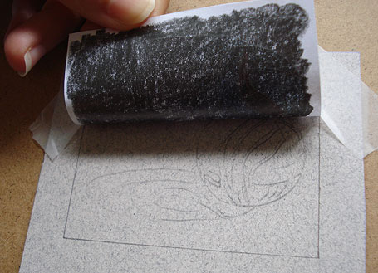
Transferring your Design
Take a sheet of transparency paper from the front and trace your design. Re-outline in sharpie.
Cover the top of the tracing paper with graphite.
Flip onto linoleum so side with graphite is laying face down. Your drawing should look reverse now.
Trace your drawing with a pencil. This will push the graphite onto the linoleum.

Slide 14
Carving
Always carve AWAY from yourself.
Keep your support hand BEHIND the direction you’re carving.
If you get stuck, wiggle a little and then gently push forward. Do not force it forward.
”V” shaped tools create skinny lines and “U” shaped tools carve away larger chunks.

Slide 15
Printing
Always lay newsprint down beneath your workspace.
Organize workspace as shown here.
Ink tray and brayer
Inking Station
Clean Printing Paper

Slide 16
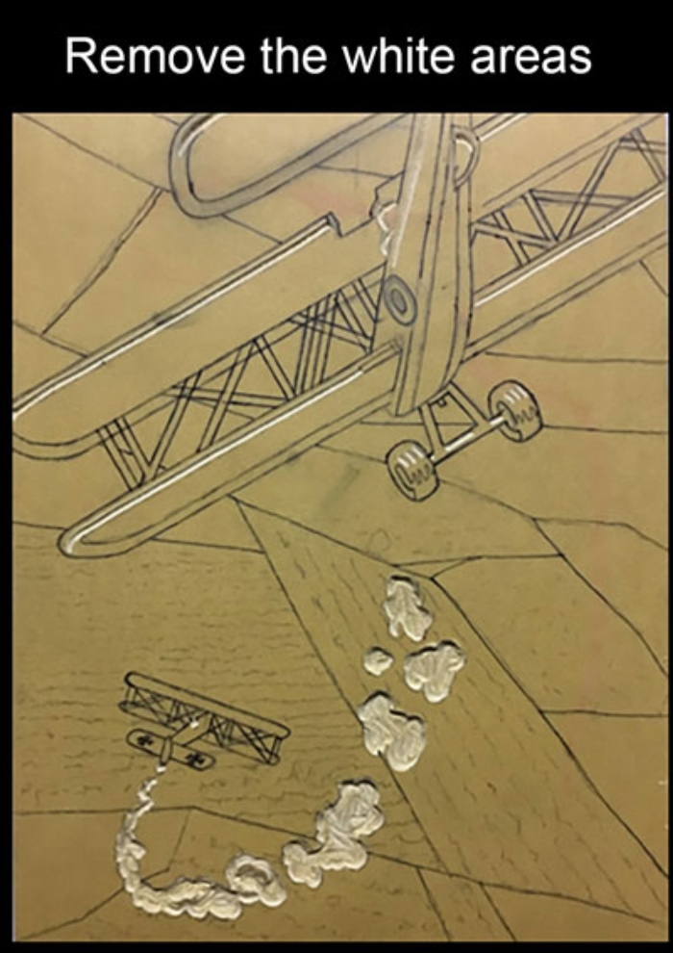
Printing/Carving Process
Step 1: Identify the parts of your print that should remain white. CARVE OUT THE WHITE PARTS.

Slide 17
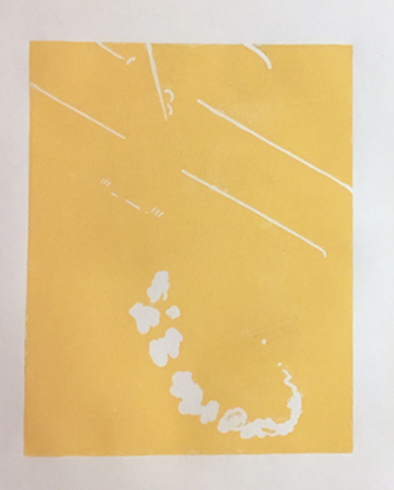
Printing/Carving Process
Step 2: Ink the block with your first color. This should be your lightest color.
The parts you carved out will remain white.
Print 4 times.
Rinse off linoleum.

Slide 18
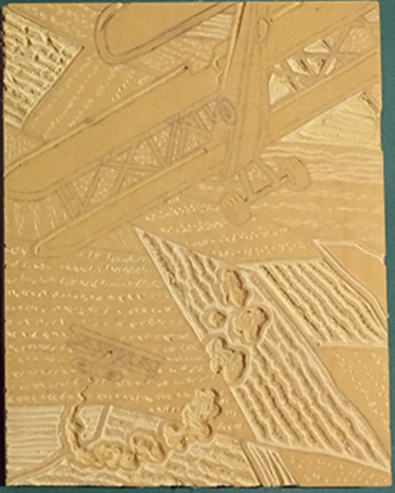
Printing/Carving Process
Step 3: Now determine what parts need to remain your first color (yellow in this example).
Carve out the parts that should remain yellow.
With reduction printmaking, you are always carving away the color that was most recently printed.

Slide 19
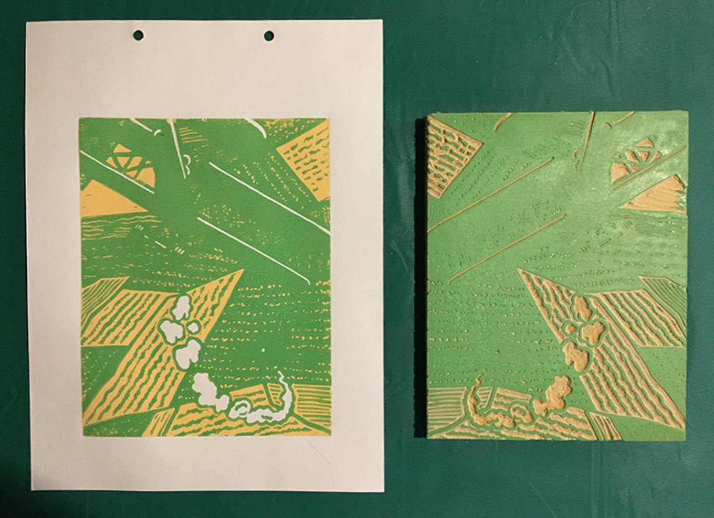
Printing/Carving Process
Step 4: Print your next darkest color on top of your first prints (green in this example).
Everything you carved out before will remain yellow.
Print 4 times.
Rinse off linoleum.

Slide 20
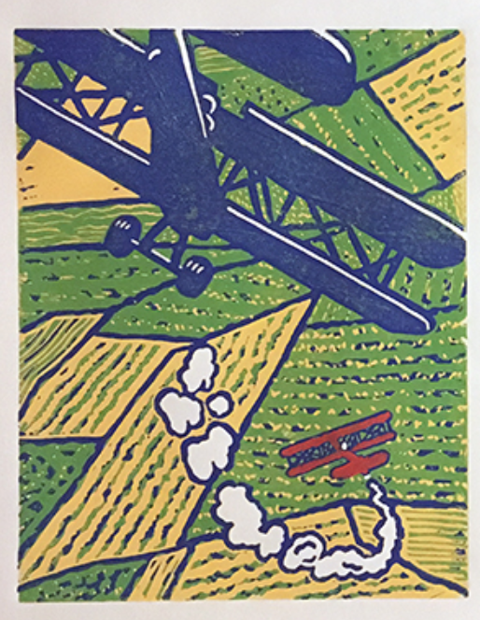
Printing/Carving Process
Step 5: Repeat pattern. Determine what parts need to remain green. Carve out those parts.
Print in your next darkest color (blue in this example)
Repeat.

